Slide 1
Online Hotel Booking System

Slide 2
Agenda 1) Project Introduction 2) Project Architecture 3) Technology Platform used for project 4) User Roles 5) Division of work within Team 6) Details of my Contribution 7) Future extensions 8) Conclusion

Slide 3
Project Introduction
Purpose of Project:
This project provides an online platform for the hotel booking . This system provides user interface for service provider to add hotel information and Customer to book Hotel.
Need of Project:
Hotel reservation systems make business easier, they allow hoteliers to work more smartly, accurately and efficiently. It is a highly convenient way for travellers to make a reservation.

Slide 4
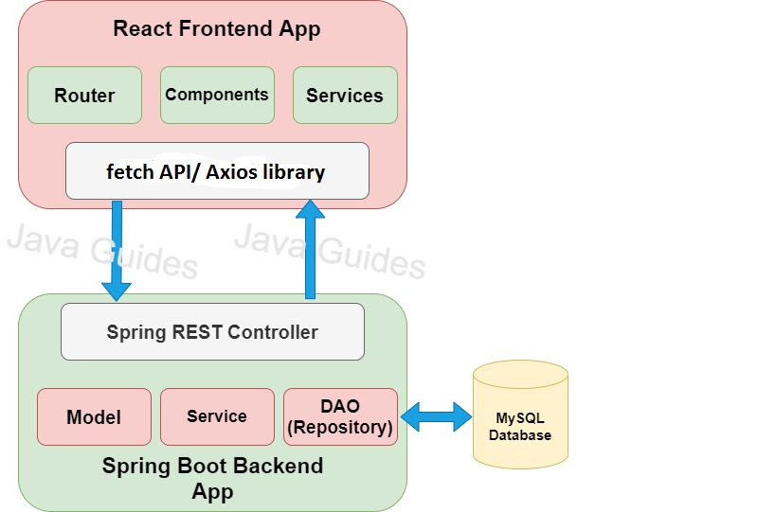
Project Architecture

Slide 5
Technology Platform used for project
Technologies Used:
Java
Spring Boot REST API
JPA
React JS
Bootstrap
MySQL

Slide 6
Why React ?
React allows developers to create large web applications that can change data, without reloading the page.
The main purpose of React is to be fast, scalable, and simple.
It works only on user interfaces in the application.
This corresponds to the view in the MVC template

Slide 7
Why Spring Boot Rest API?
It gives rapid application development.
It provides a flexible way to configure Java Beans, XML configurations, and Database Transactions.
No need to provide runtime environment(embedded tomcat service)
In Spring Boot, everything is auto configured; no manual configurations are needed.

Slide 8
User Roles
Users:
Customer
Service Provider
Admin
User Roles:
Customer:- Create Account, Book Room
Service Provider:-Create Account, Add Hotel
Admin:-View Users, View Hotels, Delete Users , Delete Hotels

Slide 9
Division of work within Team
We divided our work according to modules.
For customer module we worked together and for admin and service provider we divided task in a group of two.

Slide 10
Future extensions
In Future Customer can get Information about Hotel and status through Email, Whatsapp , as well as location details.
We can use payment Gateway for money transaction.

Slide 11
Conclusion
While developing a web application we get how things really work,how to manage code,how to manage changes, the procedure of developing an application,how we move module by module etc.
At the end, overall experience was good.

Slide 12
Thank You

